Slide 1
Vision Boards - 101
By Mal Moss

Slide 2

A Message from me
Special message from me

Slide 3
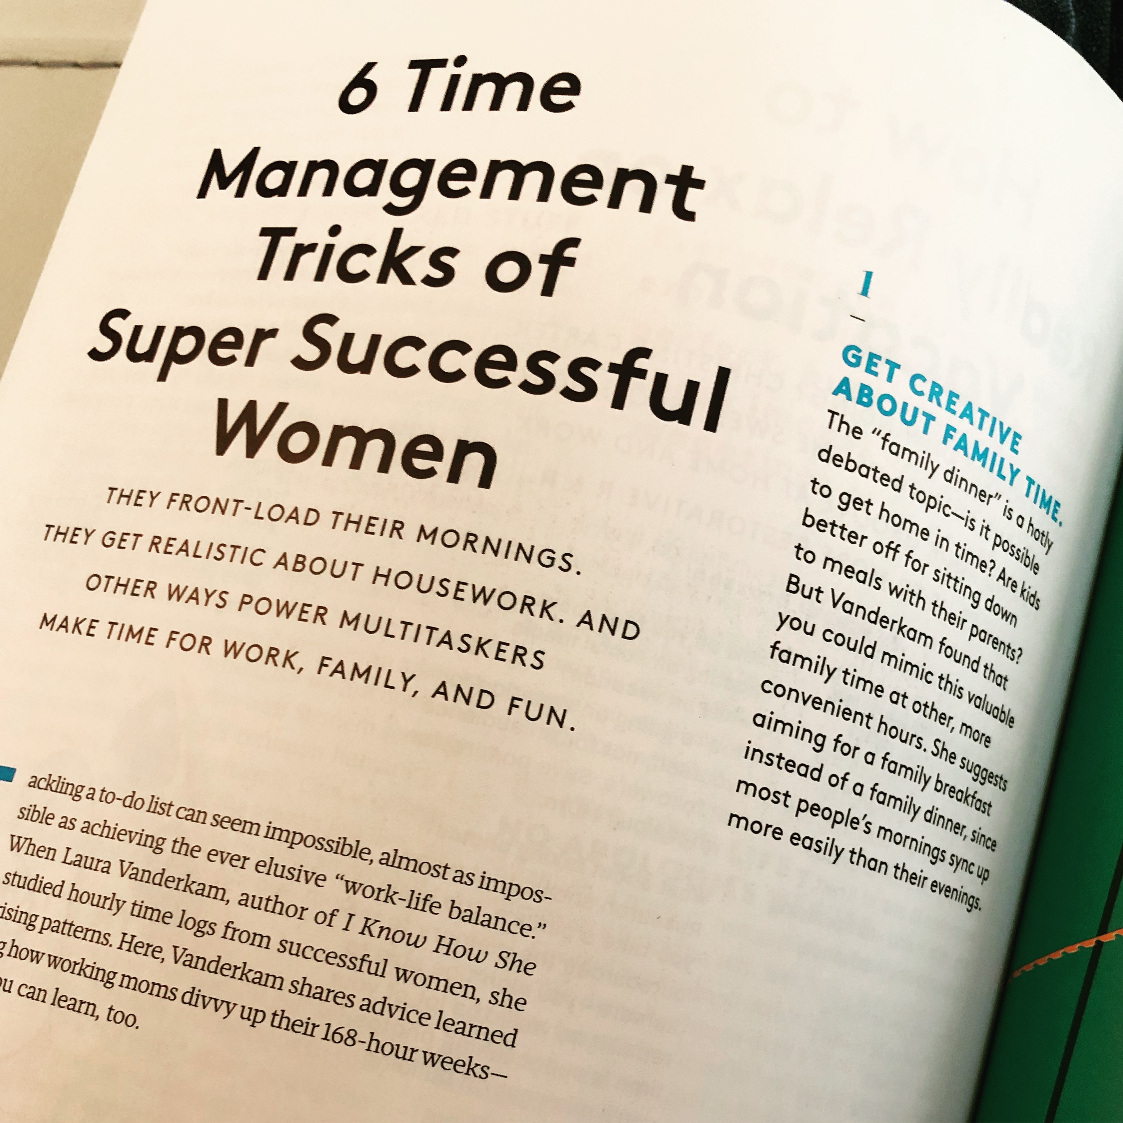

Supplies
Poster Board
Glue Stick
Scissors
Magazine, paper, printed clippings (quotes, pictures, words, anything that moves you)
Imagination and Inspiration
Poster Board
Magazine clipping

Slide 4
Background information
Vision boards are for those who find themselves identified as “creative”; or ”visionary” or struggle to write down specific goals and plans around achieving those goals.
Vision boards have no rules.
Vision boards are fun
Vision boards can be a story line to the change you want to see

Slide 5
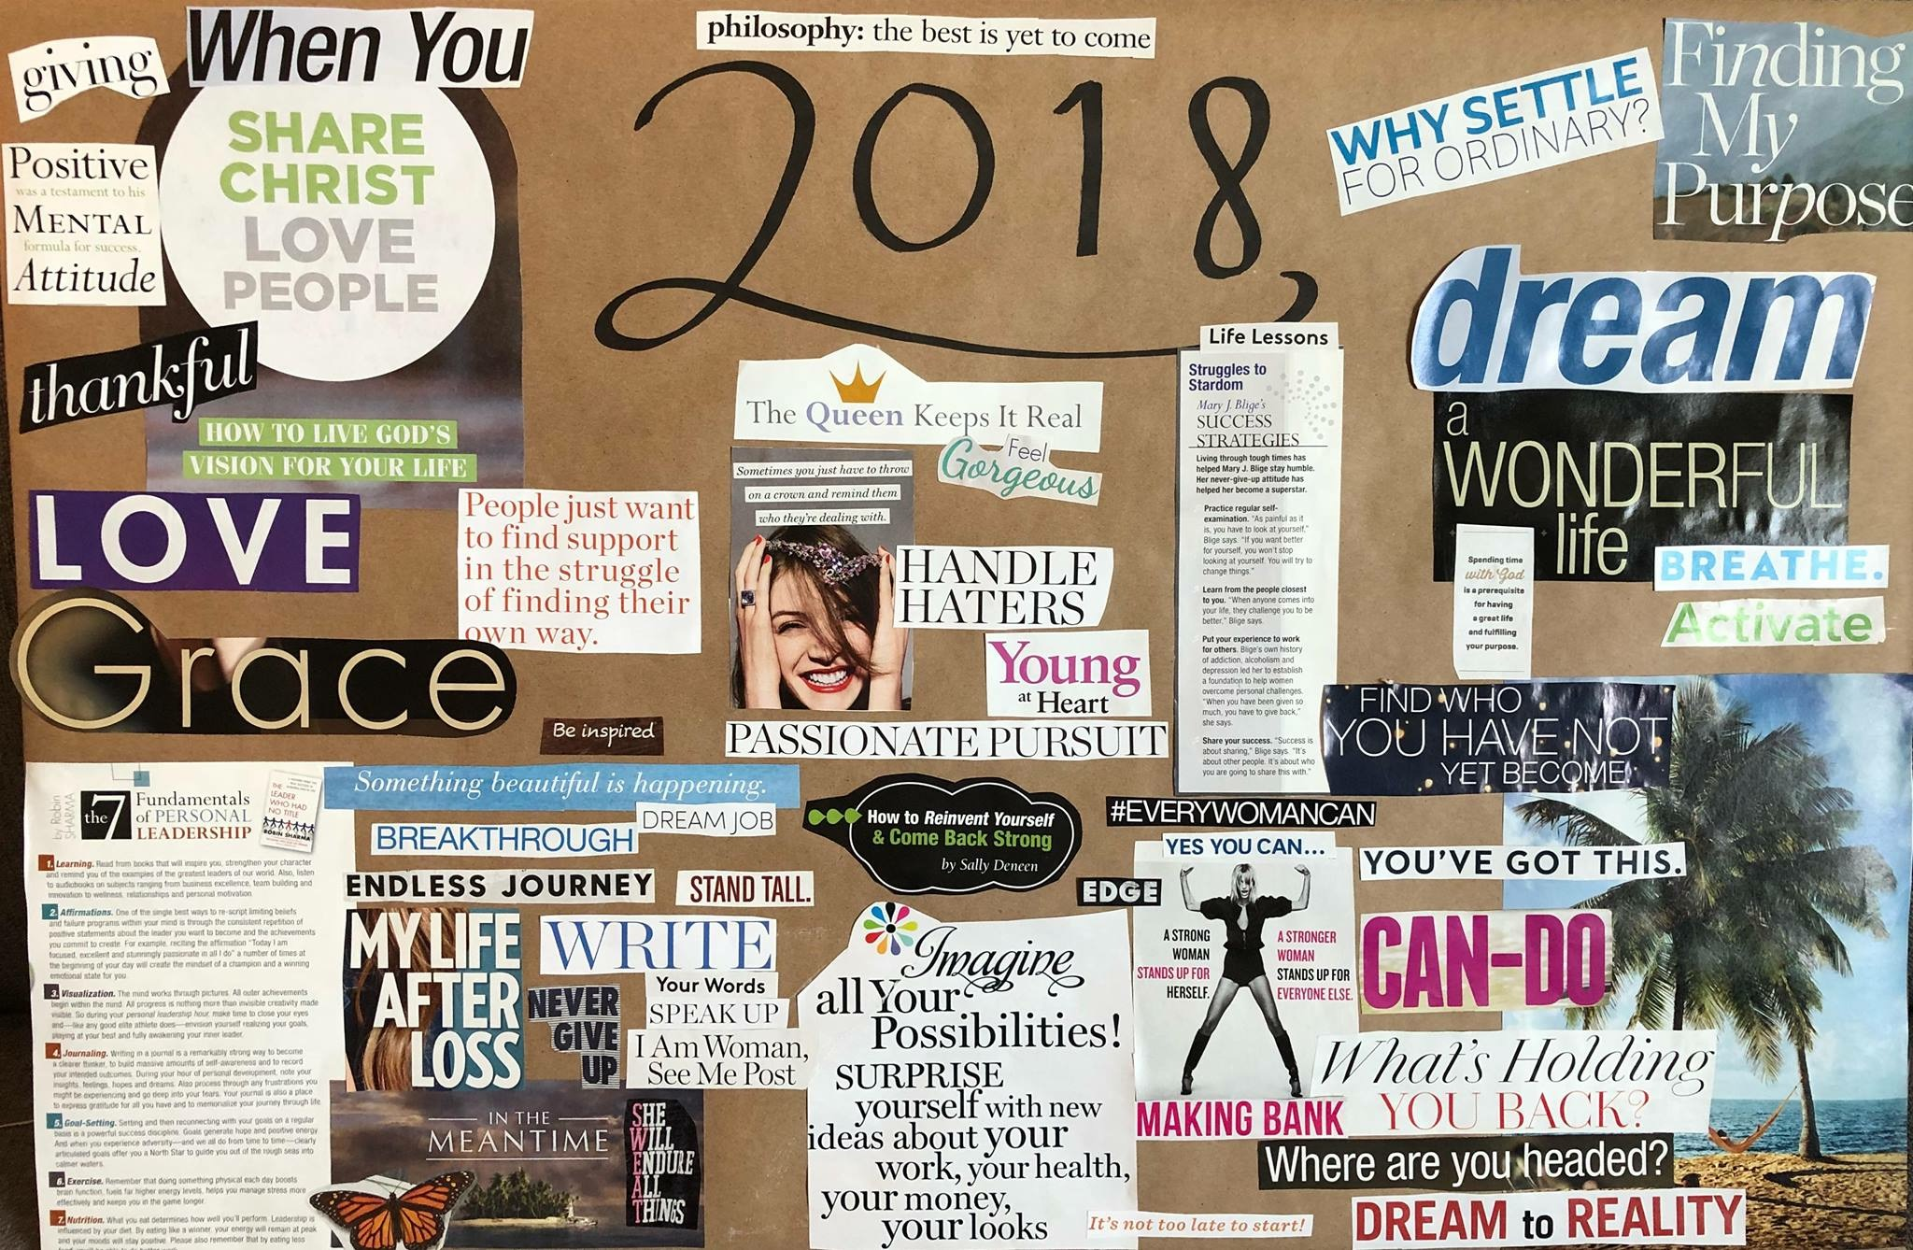
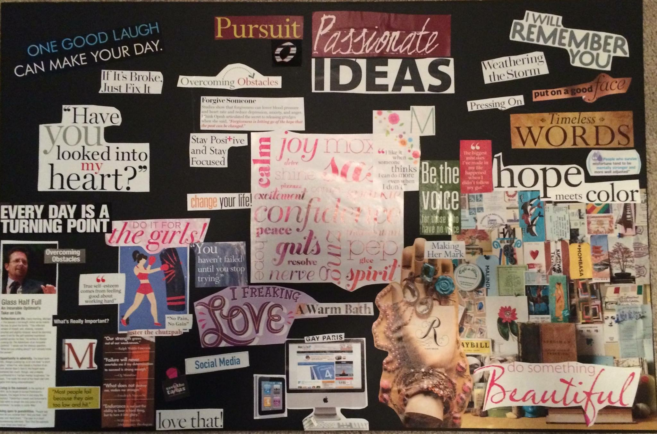
Examples
These examples are from my personal collection

